Slide 1
PPP Case Study
DND Expressway
Failed PPP
Delhi-NOIDA-Delhi (DND). First toll bridge of India built
on BOOT model

Slide 2
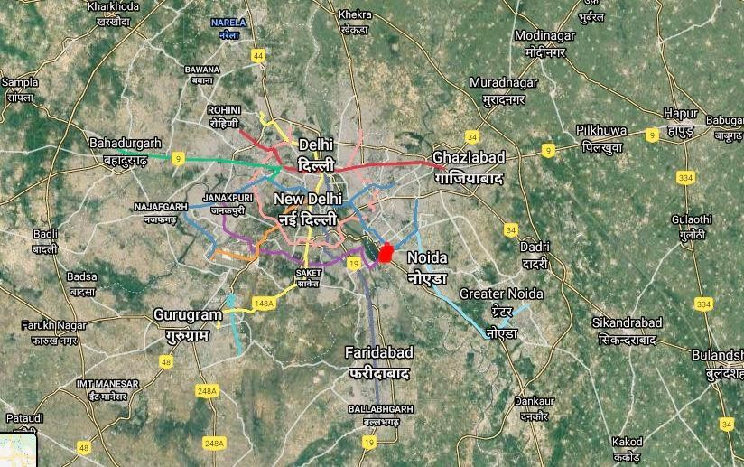
INTRODUCTION
The New Okhla Industrial Development Authority (NOIDA) is a planned city in Uttar Pradesh, India, developed in 1976.
Due to increased industrial activity, traffic volumes from Delhi to NOIDA increased, leading to frequent traffic jams.
To address this, a fourth bridge across Yamuna was built on Build, Own, Operate and Transfer mode (BOOT) to ease traffic between Delhi, East Delhi, and NOIDA. The goal is to develop a world-class integrated industrial activity and quality residential, commercial, and institutional development.
Ministry of Urban Development, GOI took initiative to create the fresh link and given limited Government resources and different administrative / government jurisdiction on the two sides of River Yamuna, MoUD invited a private partner for this project. MOU between NOIDA, Delhi Administration and IL&FS signed on April 7, 1992 to implement the Delhi Noida bridge project.
MoUD constituted a steering committee in June 1992 to supervise project implementation. Officilas from MoUD, Government of Delhi, GoUP, Delhi Administration, DDA , NOIDA, MoST & IL&FS were nominated. All project approvals were accorded by steering committee in 1995.
Figure 1 – National Capital Region map

Slide 3
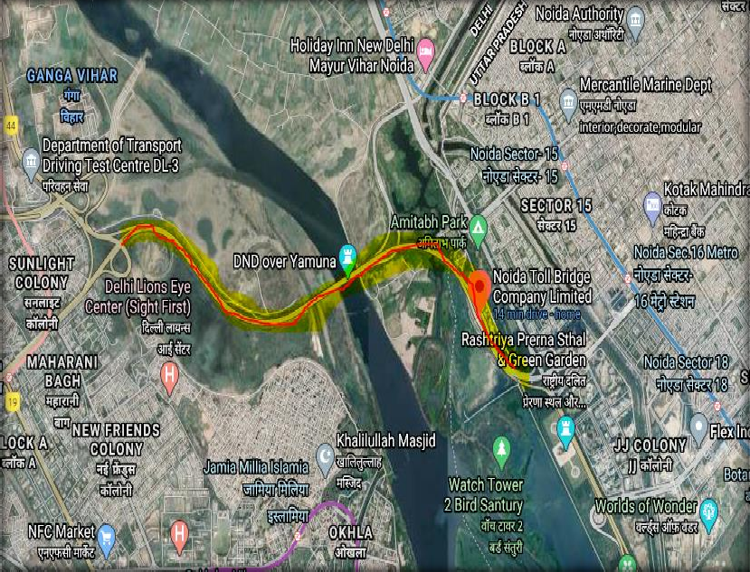
INTRODUCTION contd.
On 9th April 1996, a SPV was promoted by ILFS known as NOIDA Toll Bridge Company Limited (NTBCL) for the purpose of development, construction, operation and maintenance of bridge across river Yamuna.
On 12 November 1997, a concession agreement was entered into by NOIDA, NTBCL and IL&FS granting the right of building and operating the Delhi Noida toll bridge to NTBCL. Under the concession agreement, NTBCL has been given the right to commercially exploit the Delhi Noida toll bridge by levying tolls. The concession agreement provides that the concession shall last until the concessionaire has recovered the total project cost plus a return, which is 20% per annum of the total project cost.
At the end of the concession period all the NTBCL’s interest in the Delhi Noida toll bridge is to be transferred back to NOIDA for the nominal sum of Rs 1. On 14th Jan 1998 a “Support Agreement” was signed between Government of UP & Govt of NCT Delhi to extend complete support to NOIDA & NTBCL with respect to implementation of the project. Interoll Management Services BV, Netherlands a 100% subsidiary of Intertoll holdings (PTY), South Africa was appointed as the Operation and Maintenance Manager on 21st December 1998.
Figure 2 – NOIDA Toll Bridge

Slide 4
Salient Features of the Concession
PPP Model | Build -Own-Operate-Transfer (BOOT)
Concession Structure | Fixed Return, Variable Period
Concession Period | 30 years or earlier if return achieved
Return on Investment | Post Tax IRR of 20% pa
Project Authority | NOIDA/GoUP & DG
Concessioner | NOIDA Toll Bridge Co. Ltd
Recovery mechanism | Tolls, indexed annually to CPI
Transfer | Free of cost to NOIDA

Slide 5
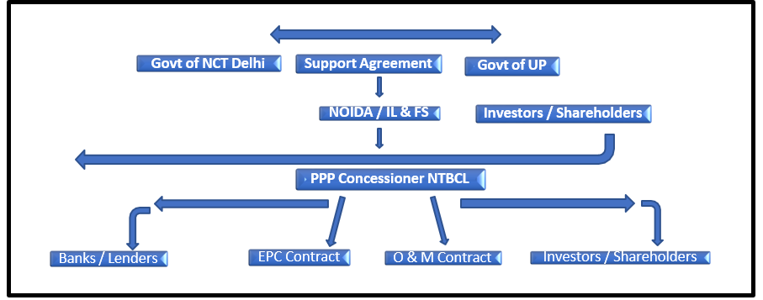
Figure 3 – Broad PPP Structure of DND Toll Bridge
Growth Scenarios
Key consideration
Key Issues
Assumption
Figure 3 – Broad PPP Structure of DND Toll Bridge

Slide 6
Growth Scenarios
Key consideration
Financing of Project
Assumption
Total cost of the project was worked out to be Rs. 408.20 Cr. This comprised an equity of Rs.
122.40 Cr and debt of Rs.285.8 Cr. NOIDA toll bridge was implemented on BOOT format through a special purpose vehicle (SPV), the NOIDA Toll Bridge Company Limited (NTBCL). Shareholders include the NOIDA Authority, IL&FS, IFCI and Intertoll.

Slide 7
Growth Scenarios
Key consideration
Key Highlights of the Project
Assumption
The DND bridge project is a landmark, path-breaking Public Private Partnership (PPP) project in India – first of its kind which confirmed that private capital could indeed be attracted to provide public infrastructure services in India despite numerous challenges in designing, structuring and developing PPP. The project was completed within budget and ahead of schedule.
This project was also successful in raising investment funds from capital markets (including an issue of GDRs overseas). Following significant shortfalls in projected traffic and revenues, it was also successful in restructuring its debt after the first year of operation
The first toll road and PPP SPV in the country, listed on the stock exchange.
The PPP project's initial revenues fell short of projected, causing significant losses. NTBCL only achieved its first book profit in 2006-17, highlighting the need for modern concession agreements to mitigate revenue shortfalls and excesses.
The concessionaire received approval for Development Rights, but the agreement should have been more transparent about PPP criteria and how Development Income would reduce NTBCL project costs.
ILFS was a lender to the SPV created for DND toll. The SPV itself was floated by IL & FS. The role of IL&FS (as a lender) in the selection processes of Independent Auditor and Independent Engineer for the SPV result in conflict. The modern-day PPP structuring clearly defines the “project authority” and “concessioner & borrower” thereby avoiding any conflict.
As a sole source negotiated project, the DND bridge project did not face the market test of commercial viability that is usually provided by a competitive concessionaire selection process. Modern day Procurement Process for PPP projects very clearly stipulates that the Private Sector Company (SPV) shall be selected through transparent and open competitive bidding process.

Slide 8
Growth Scenarios
Key consideration
Key Highlights of the Project contd.
Assumption
The concession agreement did not spell out the penalty payments or sanctions for not adhering to performance specifications/standards.
The concessionaire had been given the right to mortgage the project assets, including the project site. This reduced the concessionaire’s risk significantly. Modern day PPP projects do not provide right to mortgage.
The cost of borrowing was significantly higher for the SPV (average 16%) and banks do not fund long term debt. The high cost of borrowing had a severe negative impact on the DND PPP project. Infrastructure development requires long-term low-cost capital.
To conclude the concession agreement for the DND bridge project had several features that weighed the contract in favor of the private partner and that, from a public policy viewpoint, departed from best practice contract design.
Some of the aspects mentioned above reflect errors of inexperience that could be expected in one of the first BOOT projects successfully promoted in India.

Slide 9
Growth Scenarios
Key consideration
Key Project Benefits
Assumption
Substantial saving in travel time between Delhi & NOIDA
Reduction in fuel consumption and pollution
Saving in fuel and other vehicle operating costs to the users
Direct employment during construction and operation
Reduced congestion on existing bridges
Improved linkages between NOIDA and Delhi with stimulus to overall economic activity in the region.

Slide 10
Efficacy of PPP Projects in India: This project confirmed that private capital could indeed be attracted to provide public infrastructure services in India despite numerous challenges in designing, structuring and developing. There is now an example of a major toll bridge in a major urban area in India, where there was no such example earlier.
Treatment of shortfall / surplus in revenue from projected figures: The shortfall in revenues from toll collection from the initial projections as per the traffic study was a key learning from this project. Modern day Concession agreements mitigate both scenarios of shortfall as well as excess in revenue projects. The actual revenues in this PPP project fell far short of projected revenues (28% of projections for the first year) in the initial years of operation of the bridge, leading to significant losses which were added to total project cost.
Willingness-to-pay: Must be evaluated very carefully in such projects. Willingness to pay must be explicitly assesses for truckers and for bus operators (individual owners as well as corporate and fleet owners and operators)
Key Learnings from the PPP

Slide 11
4. Traffic & Population forecasts: These forecasts have to be more realistic and rigorous. The reason for lower- than-expected traffic, particularly in the initial years was attributed to inadequate feasibility analysis for this kind of a toll project.
5. Transparency in concession agreement: The concession agreement should have been more transparent about the criteria for award of PPP and the way in which Development Income would be applied towards reducing total project costs of NTBCL. Again, the modern day CAs are more transparent and explicit in defining the development rights under the concession.
6. Conflict of Interest: ILFS and its own SPV was playing multiple roles of Project authority, Lender, Concessioner and borrower. The modern-day PPP structuring clearly defines the “project authority” and “concessioner & borrower” thereby avoiding any conflict
7. Transparency in Procurement & Price Discovery: There was no formal bidding for procurement in a fair & transparent manner as is done nowadays. Thus, there was no price discovery on project bidding parameters.
Key Learnings from the PPP contd.

Slide 12
THANK YOU FOR ATTENDING

